Slide 1
Execute NonQuery
Presented By :Er.Sudan Prajapati

Slide 2
Introduction
The ExecuteNonQuery() is one of the most frequently used method in SqlCommand Object.
Is used for executing statements that do not return result sets (ie. statements like insert data , update data etc.)
The ExecuteNonQuery() performs Data Definition tasks as well as Data Manipulation tasks also.
The Data Definition tasks like creating Stored Procedures ,Views etc. perform by the ExecuteNonQuery() .
Also Data Manipulation tasks like Insert , Update , Delete etc. also perform by the ExecuteNonQuery() of SqlCommand Object.

Slide 3
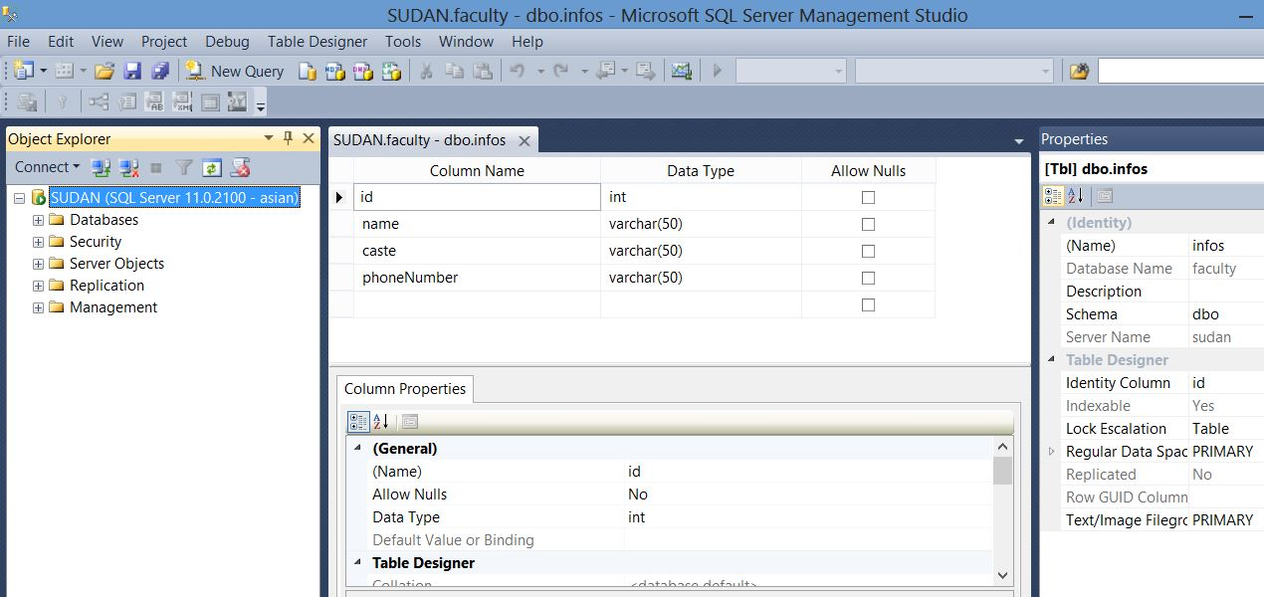
Make a table info with following column

Slide 4
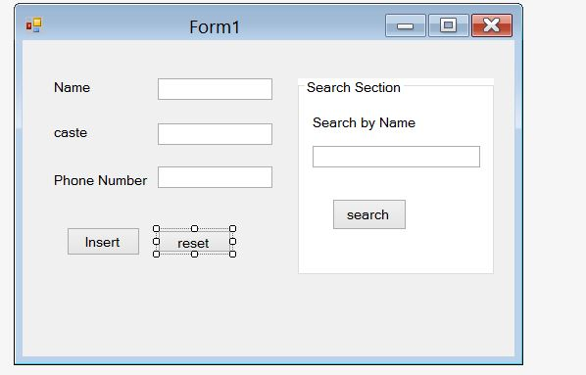
Design a Form

Slide 5
On Reset Button double click
foreach (Control c in this.Controls)
{
if (c is TextBox)
{
((TextBox)c).Clear();
}
}

Slide 6
On Inset Button Click Event
SqlCommand sqlCmd;
string connection = "data source=sudan; database=faculty; uid=asian; pwd=asian";
SqlConnection con = new SqlConnection(connection);
Double phone = 0;
phone = Double.Parse(textBox3.Text);
string query = "insert into infos values (‘" + textBox1.Text + "’,’" + textBox2.Text + “’,’" + phone + “’)";
sqlCmd = new SqlCommand(query, con);

Slide 7
try {
con.Open();
MessageBox.Show("ConnectionSuccessful");
sqlCmd.ExecuteNonQuery();
}
catch (Exception ex)
{
MessageBox.Show(ex.ToString());
}

Slide 8
On Search Button Double Click
SqlCommand sqlCmd;
string connection = "data source=sudan; database=faculty;uid=asian;pwd=asian";
SqlConnection con = new SqlConnection(connection);
Double phone = 0;
string query = "Select * from infos where name =‘" + textBox4.Text +"’";
sqlCmd = new SqlCommand(query, con);

Slide 9
try {
con.Open();
MessageBox.Show("ConnectionSuccessful");
SqlDataReader read = sqlCmd.ExecuteReader();
while (read.Read()){
textBox1.Text = read[0].ToString();
textBox2.Text = read[1].ToString();
textBox3.Text = read[2].ToString();
}}
catch (Exception ex){
MessageBox.Show(ex.ToString());
}

Slide 10
Execute Scalar
The ExecuteScalar() in C# SqlCommand Object is using for retrieve a single value from Database after the execution of the SQL Statement.
The ExecuteScalar() executes SQL statements as well as Stored Procedure and returned a scalar value on first column of first row in the returned Result Set.
If the Result Set contains more than one columns or rows , it will take only the value of first column of the first row, and all other values will ignore. If the Result Set is empty it will return a NULL reference.
It is very useful to use with aggregate functions like Count(*) orSum() etc.
When compare to ExecuteReader() , ExecuteScalar() uses fewer System resources.

Slide 11
Add New button to the form
SqlCommand sqlCmd;
string connection = "data source=sudan; database=faculty; uid=asian;pwd=asian";
SqlConnection con = new SqlConnection(connection);
string query = "SELECT COUNT(*) from infos";
sqlCmd = new SqlCommand(query, con);

Slide 12
try{
con.Open();
int results=Convert.ToInt32(sqlCmd.ExecuteScalar());
MessageBox.Show(results.ToString());
}
catch(Exception ex){
MessageBox.Show(ex.ToString());
}

